Slide 1
MPOPF Simulation and OpenDSS Validation
Aryan Ritwajeet Jha
Graduate Research Assistant
Washington State University
Notes:
Remember to hit the reset button to make sure all the page elements react properly.
There are 20 different layouts that you can choose from.

Slide 2
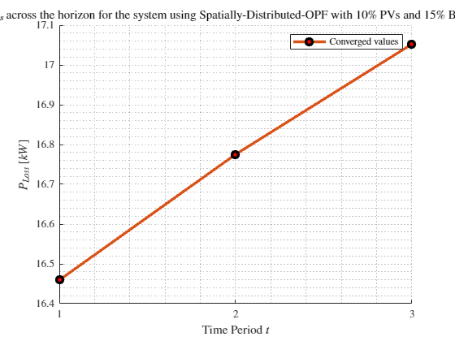
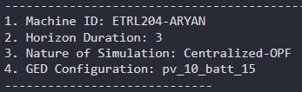
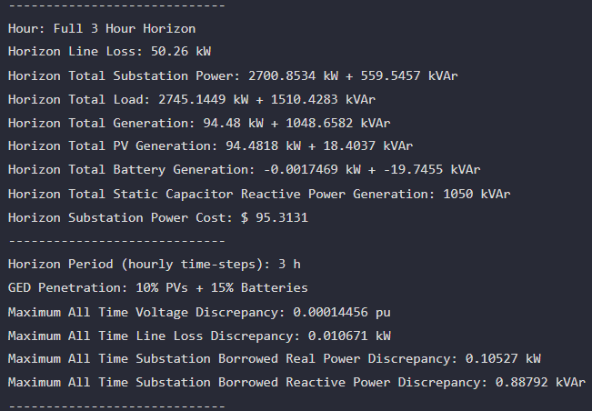
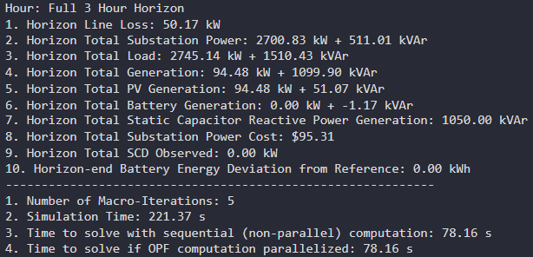

MPDOPF Verified for $T=3, PV=10\%, Batt=15\%$
strLoadShape = 'New Loadshape.LoadShape npts =3 interval = 1 mult = [0.777 0.787 0.796]'
strLoadShapePV = 'New Loadshape.LoadShapePV npts =3 interval = 1 mult = [0.8 0.9 1]'
MPCOPF Simulation Results
OpenDSS Powerflow Results

Slide 3
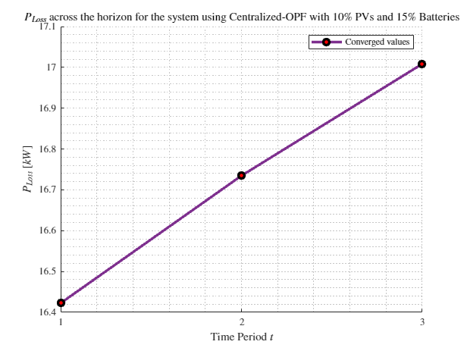
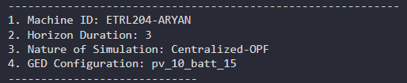
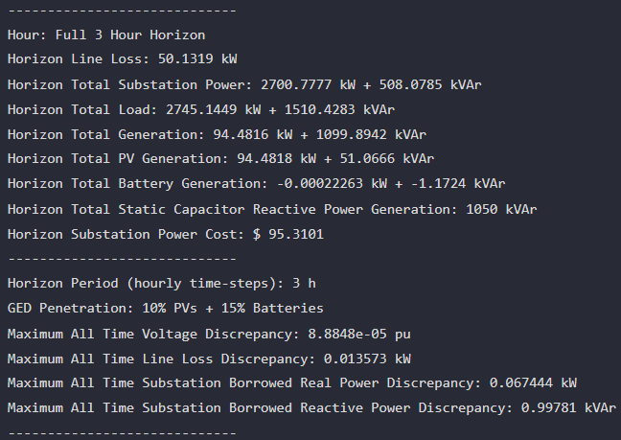
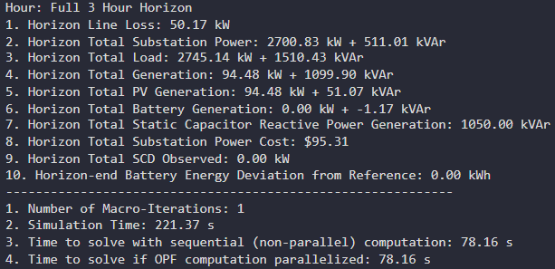

MPCOPF Verified for $T=3, PV=10\%, Batt=15\%$
strLoadShape = 'New Loadshape.LoadShape npts =3 interval = 1 mult = [0.777 0.787 0.796]'
strLoadShapePV = 'New Loadshape.LoadShapePV npts =3 interval = 1 mult = [0.8 0.9 1]'
MPDOPF Simulation Results
OpenDSS Powerflow Results

Slide 4
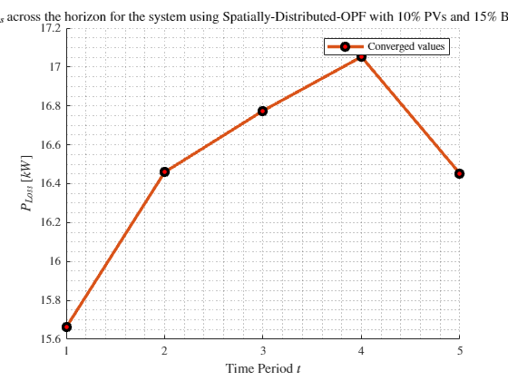
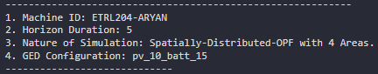
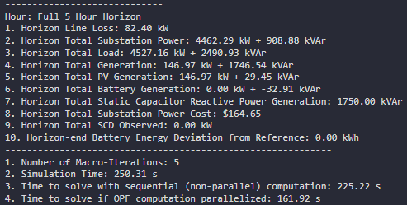
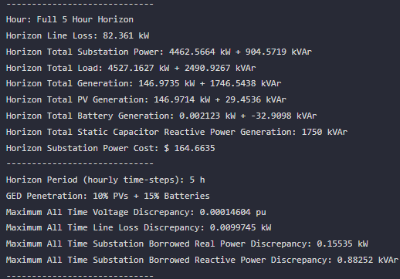

MPDOPF Verified for $T=5, PV=10\%, Batt=15\%$
strLoadShape = 'New Loadshape.LoadShape npts =5 interval = 1 mult = [0.75 0.777 0.787 0.796 0.782]'
strLoadShapePV = 'New Loadshape.LoadShapePV npts =5 interval = 1 mult = [0.5 0.8 0.9 1 1]'
MPDOPF Simulation Results
OpenDSS Powerflow Results

Slide 5
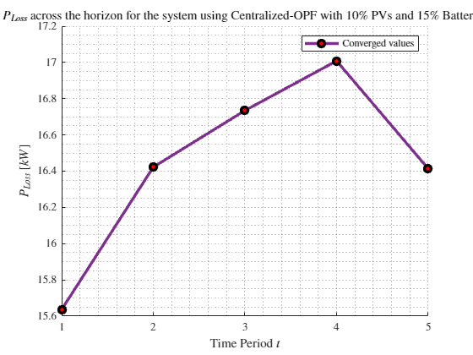
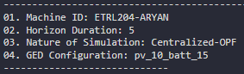
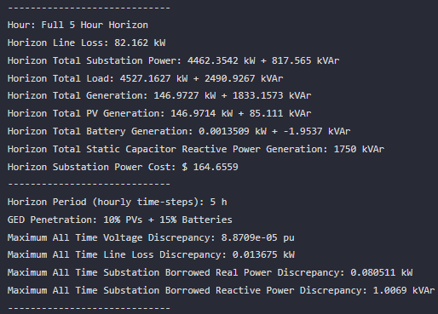
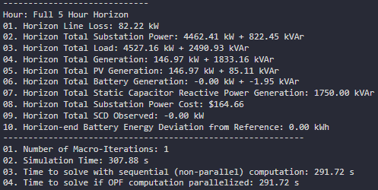

MPCOPF Verified for $T=5, PV=10\%, Batt=15\%$
strLoadShape = 'New Loadshape.LoadShape npts =5 interval = 1 mult = [0.75 0.777 0.787 0.796 0.782]'
strLoadShapePV = 'New Loadshape.LoadShapePV npts =5 interval = 1 mult = [0.5 0.8 0.9 1 1]'
MPCOPF Simulation Results
OpenDSS Powerflow Results

Slide 6
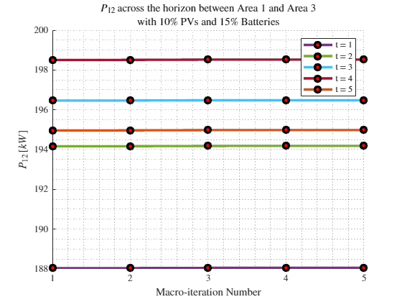
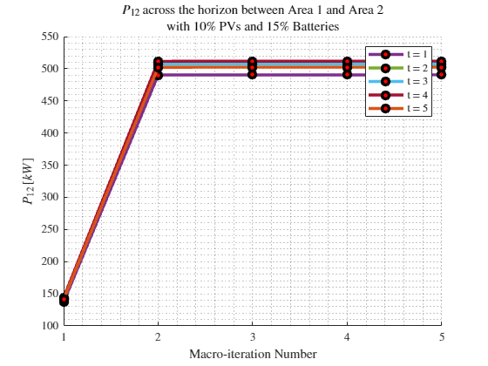
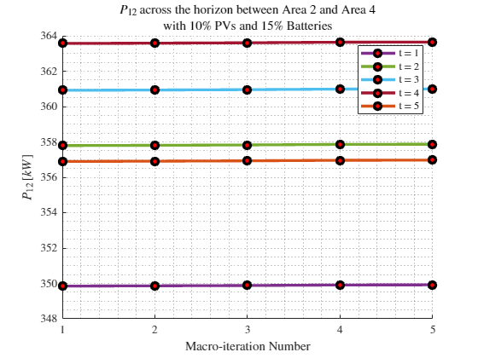

Boundary Complex Powers
MPDOPF Verified for $T=5, PV=10\%, Batt=15\%$

Slide 7
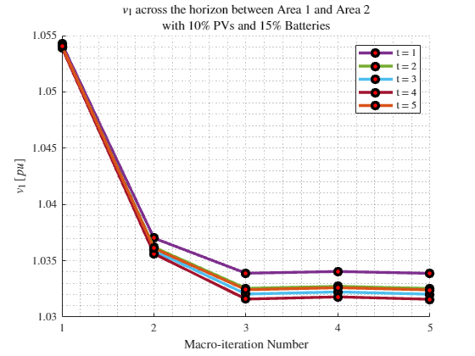
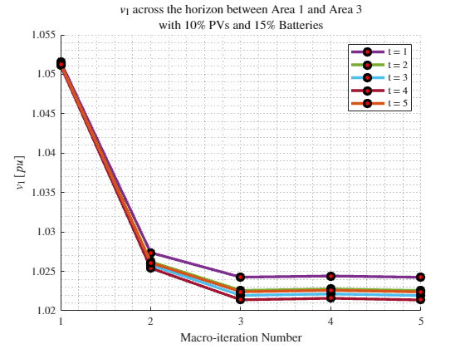
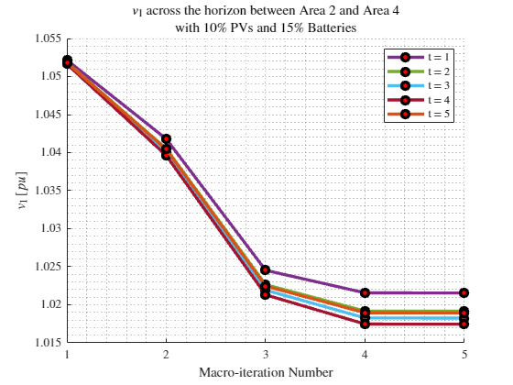
Boundary Voltages
MPDOPF Verified for $T=5, PV=10\%, Batt=15\%$

Slide 8
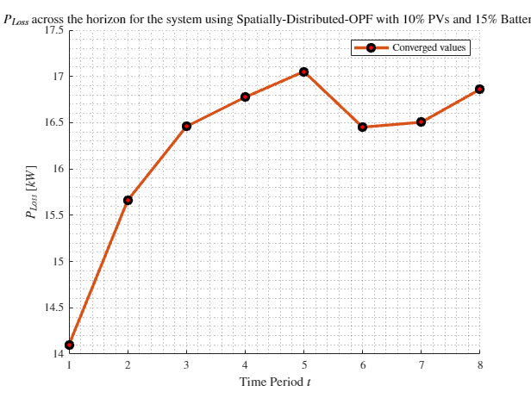
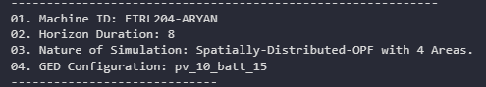
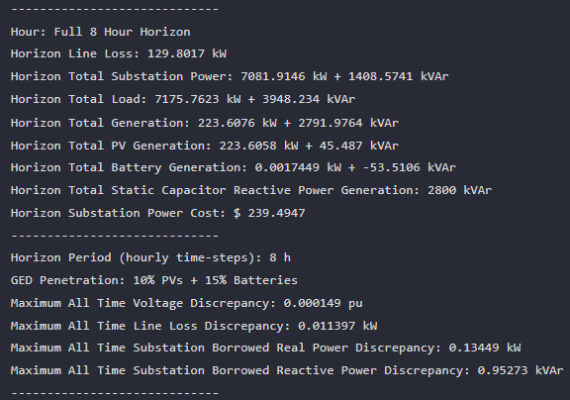
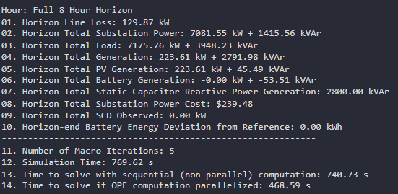

MPDOPF Verified for $T=8, PV=10\%, Batt=15\%$
strLoadShape = 'New Loadshape.LoadShape npts =8 interval = 1 mult = [0.705 0.75 0.777 0.787 0.796 0.782 0.783 0.789]'
strLoadShapePV = 'New Loadshape.LoadShapePV npts =8 interval = 1 mult = [0.3 0.5 0.8 0.9 1 1 0.99 0.9]'
MPDOPF Simulation Results
OpenDSS Powerflow Results

Slide 9
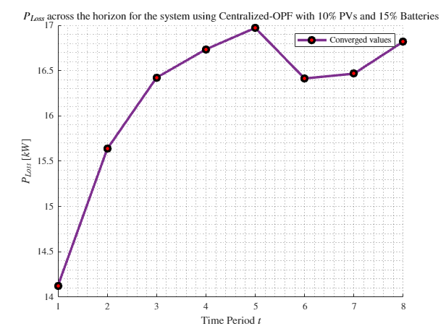
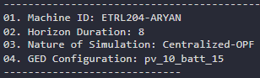
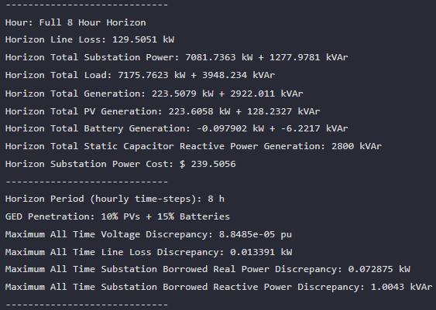
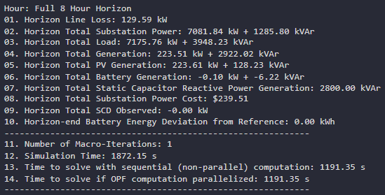

MPCOPF Verified for $T=8, PV=10\%, Batt=15\%$
strLoadShape = 'New Loadshape.LoadShape npts =8 interval = 1 mult = [0.705 0.75 0.777 0.787 0.796 0.782 0.783 0.789]'
strLoadShapePV = 'New Loadshape.LoadShapePV npts =8 interval = 1 mult = [0.3 0.5 0.8 0.9 1 1 0.99 0.9]'
MPCOPF Simulation Results
OpenDSS Powerflow Results

Slide 10
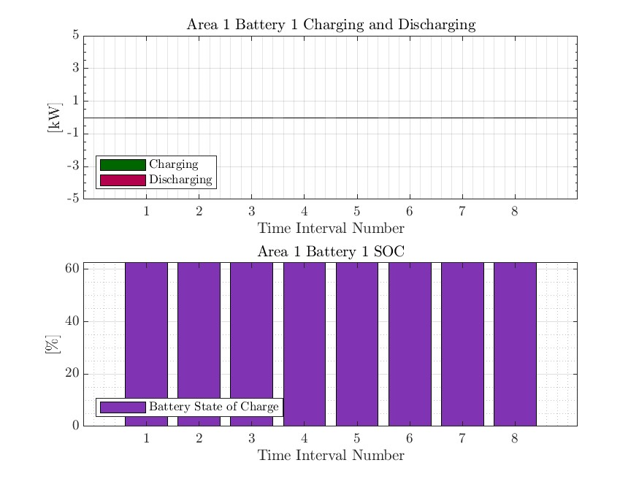




MPDOPF Verified for $T=8, PV=10\%, Batt=15\%$
strLoadShape = 'New Loadshape.LoadShape npts =8 interval = 1 mult = [0.705 0.75 0.777 0.787 0.796 0.782 0.783 0.789]'
1, 5, 6, 8 in COPF values
strLoadShapePV = 'New Loadshape.LoadShapePV npts =8 interval = 1 mult = [0.3 0.5 0.8 0.9 1 1 0.99 0.9]'

Slide 11





MPCOPF Verified for $T=8, PV=10\%, Batt=15\%$
strLoadShape = 'New Loadshape.LoadShape npts =8 interval = 1 mult = [0.705 0.75 0.777 0.787 0.796 0.782 0.783 0.789]'
strLoadShapePV = 'New Loadshape.LoadShapePV npts =8 interval = 1 mult = [0.3 0.5 0.8 0.9 1 1 0.99 0.9]'

Slide 12
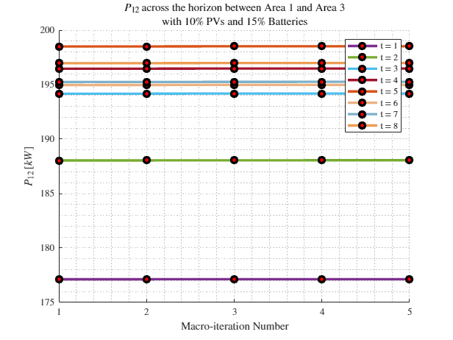
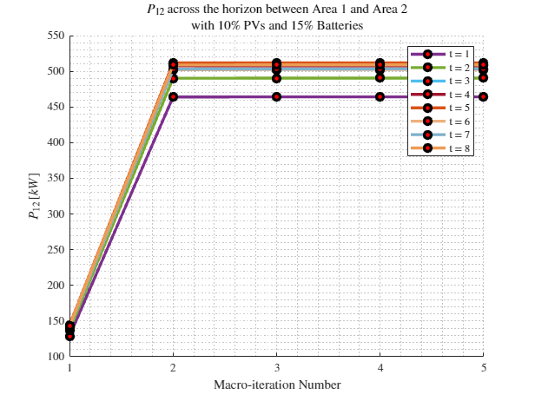
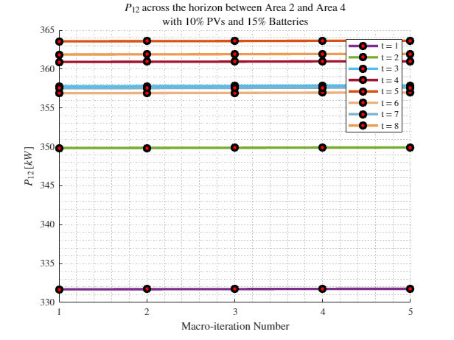

Boundary Complex Powers
strLoadShape = 'New Loadshape.LoadShape npts =8 interval = 1 mult = [0.705 0.75 0.777 0.787 0.796 0.782 0.783 0.789]'
MPDOPF Verified for $T=8, PV=10\%, Batt=15\%$
strLoadShapePV = 'New Loadshape.LoadShapePV npts =8 interval = 1 mult = [0.3 0.5 0.8 0.9 1 1 0.99 0.9]'

Slide 13
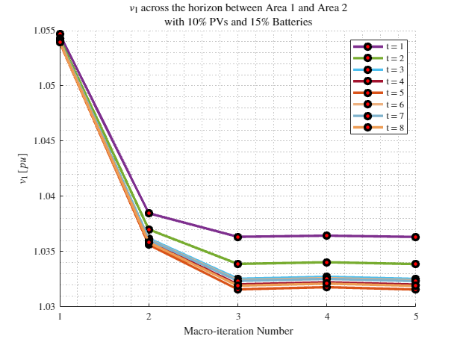
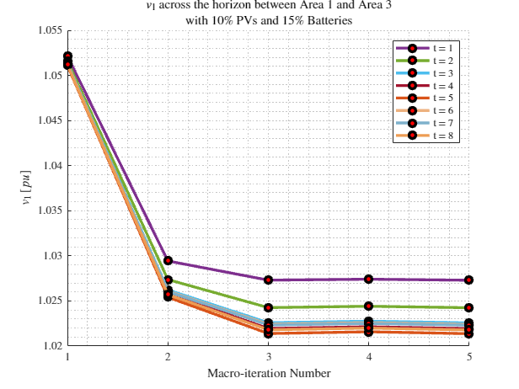
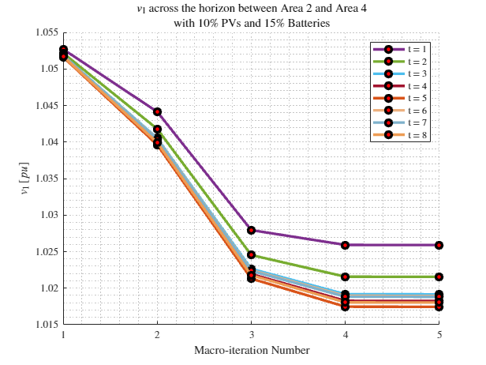
Boundary Voltages
strLoadShape = 'New Loadshape.LoadShape npts =8 interval = 1 mult = [0.705 0.75 0.777 0.787 0.796 0.782 0.783 0.789]'
MPDOPF Verified for $T=8, PV=10\%, Batt=15\%$
strLoadShapePV = 'New Loadshape.LoadShapePV npts =8 interval = 1 mult = [0.3 0.5 0.8 0.9 1 1 0.99 0.9]'

Slide 14
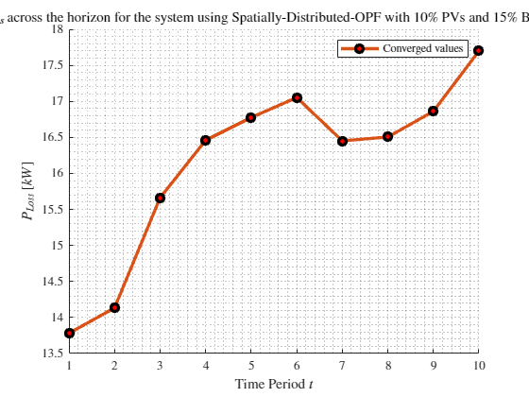
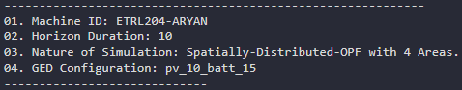
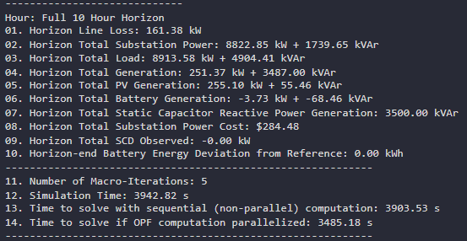
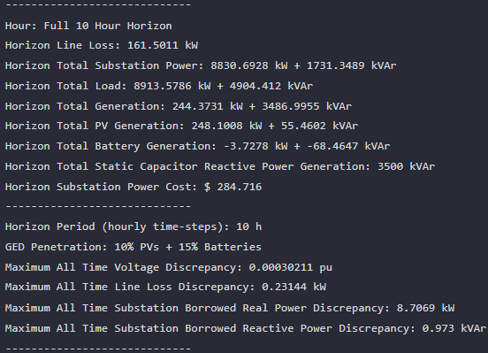

MPDOPF Verified for $T=10, PV=10\%, Batt=15\%$
strLoadShape = 'New Loadshape.LoadShape npts =10 interval = 1 mult = [0.668 0.705 0.75 0.777 0.787 0.796 0.782 0.783 0.789 0.826]'
strLoadShapePV = 'New Loadshape.LoadShapePV npts =10 interval = 1 mult = [0.2 0.3 0.5 0.8 0.9 1 1 0.99 0.9 0.7]'
MPDOPF Simulation Results
OpenDSS Powerflow Results

Slide 15
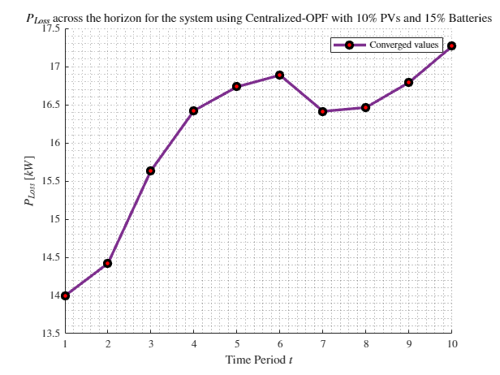
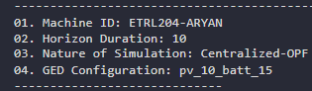
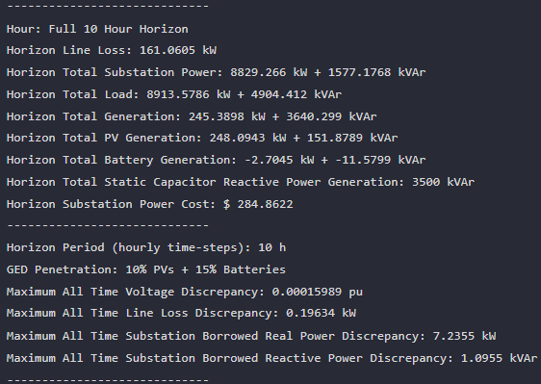
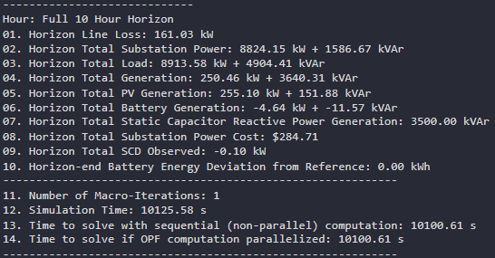

MPCOPF Verified for $T=10, PV=10\%, Batt=15\%$
strLoadShape = 'New Loadshape.LoadShape npts =10 interval = 1 mult = [0.668 0.705 0.75 0.777 0.787 0.796 0.782 0.783 0.789 0.826]'
strLoadShapePV = 'New Loadshape.LoadShapePV npts =10 interval = 1 mult = [0.2 0.3 0.5 0.8 0.9 1 1 0.99 0.9 0.7]'
MPCOPF Simulation Results
OpenDSS Powerflow Results

Slide 16
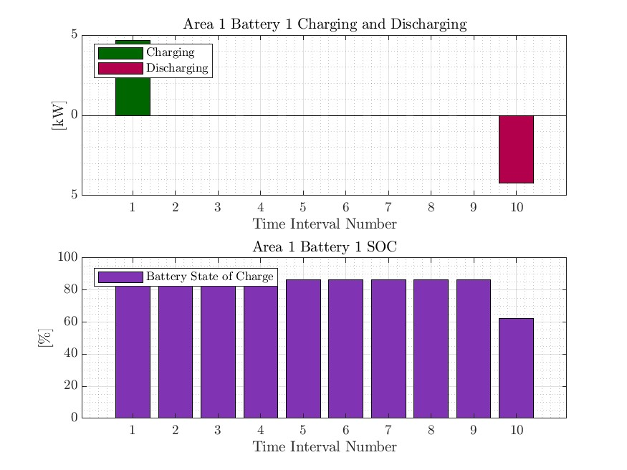
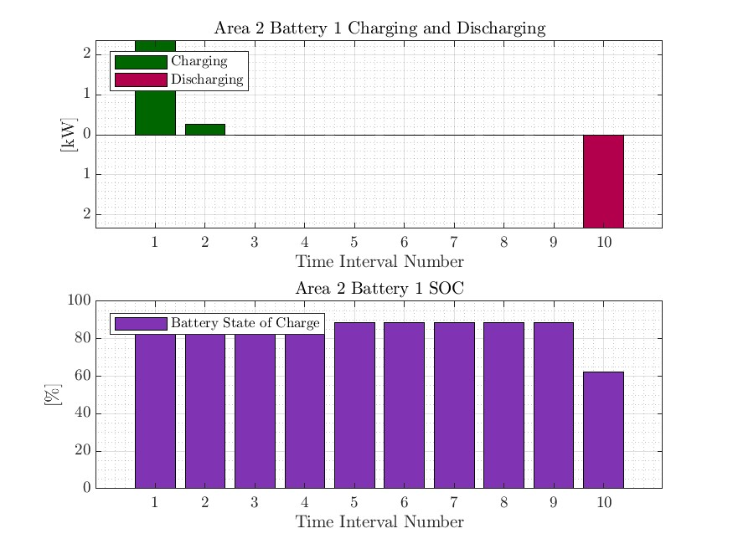
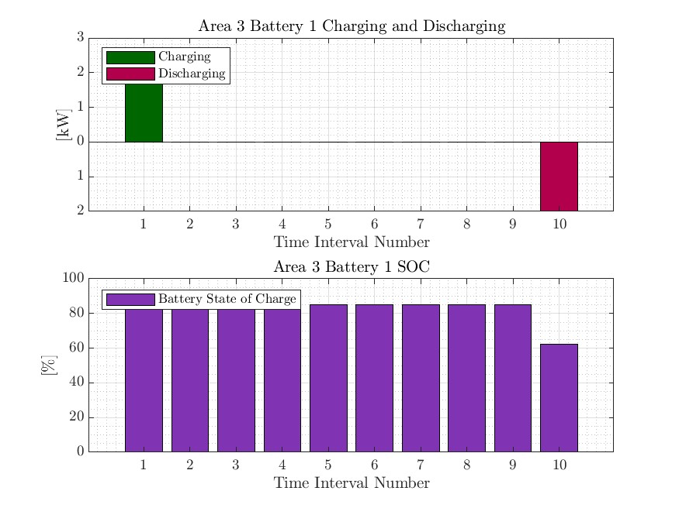
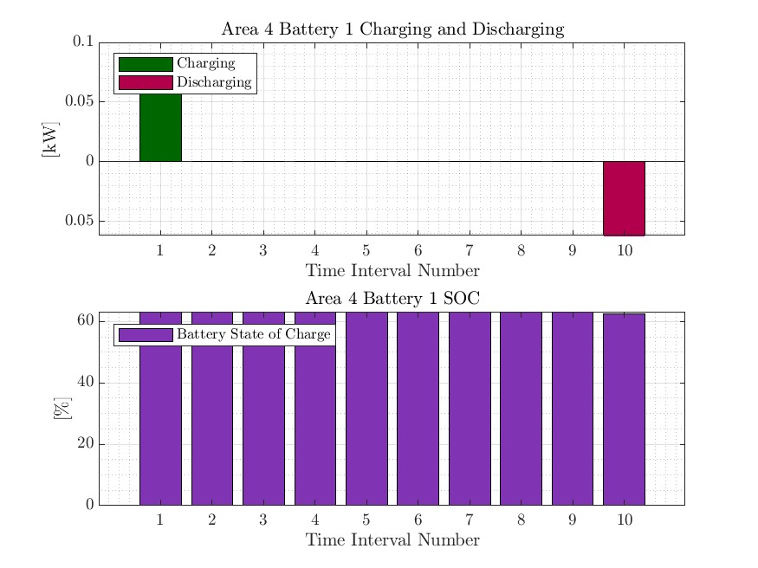

MPDOPF Verified for $T=10, PV=10\%, Batt=15\%$
strLoadShape = 'New Loadshape.LoadShape npts =10 interval = 1 mult = [0.668 0.705 0.75 0.777 0.787 0.796 0.782 0.783 0.789 0.826]'
strLoadShapePV = 'New Loadshape.LoadShapePV npts =10 interval = 1 mult = [0.2 0.3 0.5 0.8 0.9 1 1 0.99 0.9 0.7]'

Slide 17
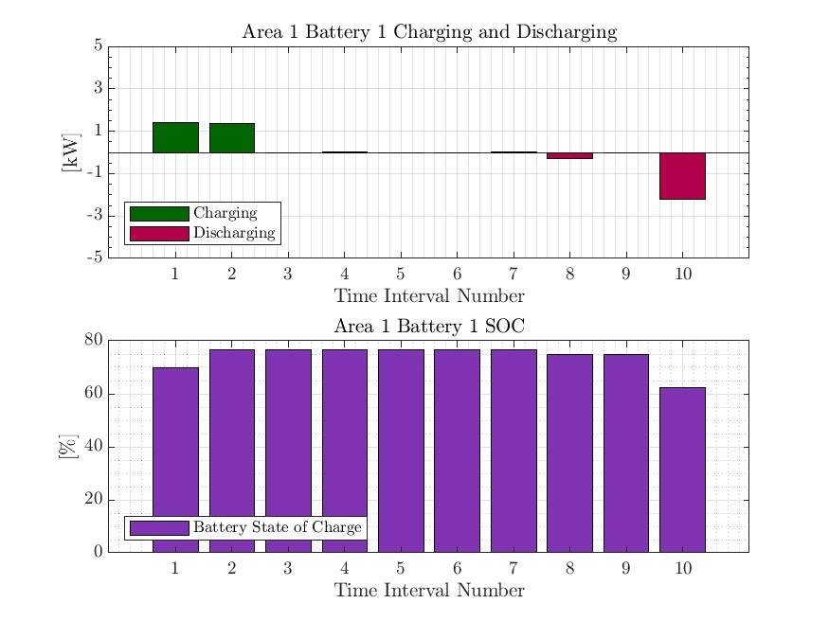




MPCOPF Verified for $T=10, PV=10\%, Batt=15\%$
strLoadShape = 'New Loadshape.LoadShape npts =10 interval = 1 mult = [0.668 0.705 0.75 0.777 0.787 0.796 0.782 0.783 0.789 0.826]'
strLoadShapePV = 'New Loadshape.LoadShapePV npts =10 interval = 1 mult = [0.2 0.3 0.5 0.8 0.9 1 1 0.99 0.9 0.7]'

Slide 18




Boundary Complex Powers
MPDOPF Verified for $T=10, PV=10\%, Batt=15\%$

Slide 19



Boundary Voltages
MPDOPF Verified for $T=10, PV=10\%, Batt=15\%$

Slide 20
MPDOPF Verified for $T=5, PV=10\%, Batt=15\%$
strLoadShape = 'New Loadshape.LoadShape npts =5 interval = 1 mult = [0.75 0.777 0.787 0.796 0.782]'
strLoadShapePV = 'New Loadshape.LoadShapePV npts =5 interval = 1 mult = [0.5 0.8 0.9 1 1]'
MPDOPF Simulation Results
OpenDSS Powerflow Results

Slide 21
MPCOPF Verified for $T=5, PV=10\%, Batt=15\%$
strLoadShape = 'New Loadshape.LoadShape npts =5 interval = 1 mult = [0.75 0.777 0.787 0.796 0.782]'
strLoadShapePV = 'New Loadshape.LoadShapePV npts =5 interval = 1 mult = [0.5 0.8 0.9 1 1]'
MPCOPF Simulation Results
OpenDSS Powerflow Results

Slide 22
MPDOPF Verified for $T=10, PV=10\%, Batt=15\%$
strLoadShape = 'New Loadshape.LoadShape npts =10 interval = 1 mult = [0.668 0.705 0.75 0.777 0.787 0.796 0.782 0.783 0.789 0.826]'
strLoadShapePV = 'New Loadshape.LoadShapePV npts =10 interval = 1 mult = [0.2 0.3 0.5 0.8 0.9 1 1 0.99 0.9 0.7]'

Slide 23
MPCOPF Verified for $T=10, PV=10\%, Batt=15\%$
strLoadShape = 'New Loadshape.LoadShape npts =10 interval = 1 mult = [0.668 0.705 0.75 0.777 0.787 0.796 0.782 0.783 0.789 0.826]'
strLoadShapePV = 'New Loadshape.LoadShapePV npts =10 interval = 1 mult = [0.2 0.3 0.5 0.8 0.9 1 1 0.99 0.9 0.7]'

Slide 24
Boundary Complex Powers
strLoadShape = 'New Loadshape.LoadShape npts =10 interval = 1 mult = [0.668 0.705 0.75 0.777 0.787 0.796 0.782 0.783 0.789 0.826]'
MPDOPF Verified for $T=5, PV=10\%, Batt=15\%$
strLoadShapePV = 'New Loadshape.LoadShapePV npts =10 interval = 1 mult = [0.2 0.3 0.5 0.8 0.9 1 1 0.99 0.9 0.7]'

Slide 25
Boundary Voltages
strLoadShape = 'New Loadshape.LoadShape npts =10 interval = 1 mult = [0.668 0.705 0.75 0.777 0.787 0.796 0.782 0.783 0.789 0.826]'
MPDOPF Verified for $T=5, PV=10\%, Batt=15\%$
strLoadShapePV = 'New Loadshape.LoadShapePV npts =10 interval = 1 mult = [0.2 0.3 0.5 0.8 0.9 1 1 0.99 0.9 0.7]'

Slide 26

Latest Slides End Here.
Previous Slides Follow

Slide 27





MPDOPF Verified for $T=1, PV=10\%, Batt=0\%$
strLoadShape = 'New Loadshape.LoadShape npts =1 interval = 1 mult = [0.787]'
strLoadShapePV = 'New Loadshape.LoadShapePV npts =1 interval = 1 mult = [0.9]'
MPDOPF Simulation Results
OpenDSS Powerflow Results

Slide 28





MPCOPF Verified for $T=1, PV=10\%, Batt=0\%$
strLoadShape = 'New Loadshape.LoadShape npts =1 interval = 1 mult = [0.787]'
strLoadShapePV = 'New Loadshape.LoadShapePV npts =1 interval = 1 mult = [0.9]'
MPCOPF Simulation Results
OpenDSS Powerflow Results

Slide 29





MPDOPF Verified for $T=1, PV=10\%, Batt=15\%$
strLoadShape = 'New Loadshape.LoadShape npts =1 interval = 1 mult = [0.787]'
strLoadShapePV = 'New Loadshape.LoadShapePV npts =1 interval = 1 mult = [0.9]'
MPDOPF Simulation Results
OpenDSS Powerflow Results

Slide 30





MPCOPF Verified for $T=1, PV=10\%, Batt=15\%$
strLoadShape = 'New Loadshape.LoadShape npts =1 interval = 1 mult = [0.787]'
strLoadShapePV = 'New Loadshape.LoadShapePV npts =1 interval = 1 mult = [0.9]'
MPCOPF Simulation Results
OpenDSS Powerflow Results

Slide 31





MPDOPF Verified for $T=2, PV=10\%, Batt=15\%$
strLoadShape = 'New Loadshape.LoadShape npts =2 interval = 1 mult = [0.787 0.796]'
strLoadShapePV = 'New Loadshape.LoadShapePV npts =2 interval = 1 mult = [0.9 1]'
MPDOPF Simulation Results
OpenDSS Powerflow Results

Slide 32





MPCOPF Verified for $T=2, PV=10\%, Batt=15\%$
strLoadShape = 'New Loadshape.LoadShape npts =2 interval = 1 mult = [0.787 0.796]'
strLoadShapePV = 'New Loadshape.LoadShapePV npts =2 interval = 1 mult = [0.9 1]'
MPCOPF Simulation Results
OpenDSS Powerflow Results

Slide 33
MPDOPF Verified for $T=3, PV=10\%, Batt=15\%$
strLoadShape = 'New Loadshape.LoadShape npts =3 interval = 1 mult = [0.777 0.787 0.796]'
strLoadShapePV = 'New Loadshape.LoadShapePV npts =3 interval = 1 mult = [0.8 0.9 1]'
MPDOPF Simulation Results
OpenDSS Powerflow Results

Slide 34




MPCOPF Verified for $T=3, PV=10\%, Batt=15\%$
strLoadShape = 'New Loadshape.LoadShape npts =3 interval = 1 mult = [0.777 0.787 0.796]'
strLoadShapePV = 'New Loadshape.LoadShapePV npts =3 interval = 1 mult = [0.8 0.9 1]'
MPCOPF Simulation Results
OpenDSS Powerflow Results

Slide 35




MPDOPF Verified for $T=5, PV=10\%, Batt=15\%$
strLoadShape = 'New Loadshape.LoadShape npts =5 interval = 1 mult = [0.75 0.777 0.787 0.796 0.782]'
strLoadShapePV = 'New Loadshape.LoadShapePV npts =5 interval = 1 mult = [0.5 0.8 0.9 1 1]'
MPDOPF Simulation Results
OpenDSS Powerflow Results

Slide 36




MPCOPF Verified for $T=5, PV=10\%, Batt=15\%$
strLoadShape = 'New Loadshape.LoadShape npts =5 interval = 1 mult = [0.75 0.777 0.787 0.796 0.782]'
strLoadShapePV = 'New Loadshape.LoadShapePV npts =5 interval = 1 mult = [0.5 0.8 0.9 1 1]'
MPCOPF Simulation Results
OpenDSS Powerflow Results

Slide 37





MPDOPF Verified for $T=5, PV=10\%, Batt=15\%$
strLoadShape = 'New Loadshape.LoadShape npts =5 interval = 1 mult = [0.75 0.777 0.787 0.796 0.782]'
strLoadShapePV = 'New Loadshape.LoadShapePV npts =5 interval = 1 mult = [0.5 0.8 0.9 1 1]'

Slide 38





MPCOPF Verified for $T=5, PV=10\%, Batt=15\%$
strLoadShape = 'New Loadshape.LoadShape npts =5 interval = 1 mult = [0.75 0.777 0.787 0.796 0.782]'
strLoadShapePV = 'New Loadshape.LoadShapePV npts =5 interval = 1 mult = [0.5 0.8 0.9 1 1]'

Slide 39



Boundary Complex Powers
MPDOPF Verified for $T=5, PV=10\%, Batt=15\%$

Slide 40



Boundary Voltages
MPDOPF Verified for $T=5, PV=10\%, Batt=15\%$

Slide 41




MPDOPF Verified for $T=10, PV=10\%, Batt=15\%$
strLoadShape = 'New Loadshape.LoadShape npts =10 interval = 1 mult = [0.668 0.705 0.75 0.777 0.787 0.796 0.782 0.783 0.789 0.826]'
strLoadShapePV = 'New Loadshape.LoadShapePV npts =10 interval = 1 mult = [0.2 0.3 0.5 0.8 0.9 1 1 0.99 0.9 0.7]'
MPDOPF Simulation Results
OpenDSS Powerflow Results

Slide 42




MPCOPF Verified for $T=10, PV=10\%, Batt=15\%$
strLoadShape = 'New Loadshape.LoadShape npts =10 interval = 1 mult = [0.668 0.705 0.75 0.777 0.787 0.796 0.782 0.783 0.789 0.826]'
strLoadShapePV = 'New Loadshape.LoadShapePV npts =10 interval = 1 mult = [0.2 0.3 0.5 0.8 0.9 1 1 0.99 0.9 0.7]'
MPCOPF Simulation Results
OpenDSS Powerflow Results

Slide 43





MPDOPF Verified for $T=10, PV=10\%, Batt=15\%$
strLoadShape = 'New Loadshape.LoadShape npts =10 interval = 1 mult = [0.668 0.705 0.75 0.777 0.787 0.796 0.782 0.783 0.789 0.826]'
strLoadShapePV = 'New Loadshape.LoadShapePV npts =10 interval = 1 mult = [0.2 0.3 0.5 0.8 0.9 1 1 0.99 0.9 0.7]'

Slide 44





MPCOPF Verified for $T=10, PV=10\%, Batt=15\%$
strLoadShape = 'New Loadshape.LoadShape npts =10 interval = 1 mult = [0.668 0.705 0.75 0.777 0.787 0.796 0.782 0.783 0.789 0.826]'
strLoadShapePV = 'New Loadshape.LoadShapePV npts =10 interval = 1 mult = [0.2 0.3 0.5 0.8 0.9 1 1 0.99 0.9 0.7]'

Slide 45



Boundary Complex Powers
MPDOPF Verified for $T=10, PV=10\%, Batt=15\%$

Slide 46



Boundary Voltages
MPDOPF Verified for $T=10, PV=10\%, Batt=15\%$

Slide 47

MPDOPF Verified for $T=t, PV=10\%, Batt=15\%$
strLoadShape = 'New Loadshape.LoadShape npts =1 interval = 1 mult = [0.787]'
strLoadShapePV = 'New Loadshape.LoadShapePV npts =1 interval = 1 mult = [0.9]'
MPDOPF Simulation Results
OpenDSS Powerflow Results

Slide 48

MPCOPF Verified for $T=t, PV=10\%, Batt=15\%$
strLoadShape = 'New Loadshape.LoadShape npts =1 interval = 1 mult = [0.787]'
strLoadShapePV = 'New Loadshape.LoadShapePV npts =1 interval = 1 mult = [0.9]'
MPCOPF Simulation Results
OpenDSS Powerflow Results

Slide 49









MPDOPF Verified for $T=1, PV=10\%, Batt=10\%$
strLoadShape = 'New Loadshape.LoadShape npts =1 interval = 1 mult = [0.787]'
strLoadShapePV = 'New Loadshape.LoadShapePV npts =1 interval = 1 mult = [0.9]'
MPDOPF Simulation Results
OpenDSS Powerflow Results
$10\%$GED = $11$ buses

Slide 50








MPCOPF Verified for $T=1, PV=10\%, Batt=10\%$
strLoadShape = 'New Loadshape.LoadShape npts =1 interval = 1 mult = [0.787]'
strLoadShapePV = 'New Loadshape.LoadShapePV npts =1 interval = 1 mult = [0.9]'
MPCOPF Simulation Results
OpenDSS Powerflow Results
$10\%$GED = $11$ buses

Slide 51






MPDOPF Verified for $T=1, PV=100\%, Batt=100\%$
strLoadShape = 'New Loadshape.LoadShape npts =1 interval = 1 mult = [0.787]'
strLoadShapePV = 'New Loadshape.LoadShapePV npts =1 interval = 1 mult = [0.9]'
MPDOPF Simulation Results
OpenDSS Powerflow Results
$100\%$GED = $85$ buses

Slide 52





MPCOPF Verified for $T=1, PV=100\%, Batt=100\%$
strLoadShape = 'New Loadshape.LoadShape npts =1 interval = 1 mult = [0.787]'
strLoadShapePV = 'New Loadshape.LoadShapePV npts =1 interval = 1 mult = [0.9]'
MPCOPF Simulation Results
OpenDSS Powerflow Results
$100\%$GED = $85$ buses

Slide 53






MPDOPF Verified for $T=5, PV=10\%, Batt=10\%$
strLoadShape = 'New Loadshape.LoadShape npts =5 interval = 1 mult = [0.75 0.777 0.787 0.796 0.782]'
strLoadShapePV = 'New Loadshape.LoadShapePV npts =5 interval = 1 mult = [0.5 0.8 0.9 1 1]'
MPDOPF Simulation Results
OpenDSS Powerflow Results
$10\%$GED = $11$ buses

Slide 54






MPCOPF Verified for $T=5, PV=10\%, Batt=10\%$
strLoadShape = 'New Loadshape.LoadShape npts =5 interval = 1 mult = [0.75 0.777 0.787 0.796 0.782]'
strLoadShapePV = 'New Loadshape.LoadShapePV npts =5 interval = 1 mult = [0.5 0.8 0.9 1 1]'
MPCOPF Simulation Results
OpenDSS Powerflow Results
$10\%$GED = $9$ buses

Slide 55





MPDOPF Verified for $T=6, PV=10\%, Batt=10\%$
strLoadShape = 'New Loadshape.LoadShape npts =6 interval = 1 mult = [0.75 0.777 0.787 0.796 0.782 0.783]'
strLoadShapePV = 'New Loadshape.LoadShapePV npts =6 interval = 1 mult = [0.5 0.8 0.9 1 1 0.99]'
MPDOPF Simulation Results
OpenDSS Powerflow Results
$10\%$GED = $11$ buses

Slide 56





MPCOPF Verified for $T=6, PV=10\%, Batt=10\%$
strLoadShape = 'New Loadshape.LoadShape npts =6 interval = 1 mult = [0.75 0.777 0.787 0.796 0.782 0.783]'
strLoadShapePV = 'New Loadshape.LoadShapePV npts =6 interval = 1 mult = [0.5 0.8 0.9 1 1 0.99]'
MPCOPF Simulation Results
OpenDSS Powerflow Results
$10\%$GED = $9$ buses

Slide 57





MPDOPF Verified for $T=7, PV=10\%, Batt=10\%$
strLoadShape = 'New Loadshape.LoadShape npts =7 interval = 1 mult = [0.705 0.75 0.777 0.787 0.796 0.782 0.783]'
strLoadShapePV = 'New Loadshape.LoadShapePV npts =7 interval = 1 mult = [0.3 0.5 0.8 0.9 1 1 0.99]'
MPDOPF Simulation Results
OpenDSS Powerflow Results
$10\%$GED = $11$ buses

Slide 58





MPCOPF Verified for $T=7, PV=10\%, Batt=10\%$
strLoadShape = 'New Loadshape.LoadShape npts =7 interval = 1 mult = [0.705 0.75 0.777 0.787 0.796 0.782 0.783]'
strLoadShapePV = 'New Loadshape.LoadShapePV npts =7 interval = 1 mult = [0.3 0.5 0.8 0.9 1 1 0.99]'
MPCOPF Simulation Results
OpenDSS Powerflow Results
$10\%$GED = $9$ buses

Slide 59





MPDOPF Verified for $T=8, PV=10\%, Batt=10\%$
strLoadShape = 'New Loadshape.LoadShape npts =8 interval = 1 mult = [0.705 0.75 0.777 0.787 0.796 0.782 0.783 0.789]'
strLoadShapePV = 'New Loadshape.LoadShapePV npts =8 interval = 1 mult = [0.3 0.5 0.8 0.9 1 1 0.99 0.9]'
MPDOPF Simulation Results
OpenDSS Powerflow Results
$10\%$GED = $11$ buses

Slide 60





MPCOPF Verified for $T=8, PV=10\%, Batt=10\%$
strLoadShape = 'New Loadshape.LoadShape npts =8 interval = 1 mult = [0.705 0.75 0.777 0.787 0.796 0.782 0.783 0.789]'
strLoadShapePV = 'New Loadshape.LoadShapePV npts =8 interval = 1 mult = [0.3 0.5 0.8 0.9 1 1 0.99 0.9]'
MPCOPF Simulation Results
OpenDSS Powerflow Results
$10\%$GED = $9$ buses

Slide 61





MPDOPF Verified for $T=9, PV=10\%, Batt=10\%$
strLoadShape = 'New Loadshape.LoadShape npts =9 interval = 1 mult = [0.668 0.705 0.75 0.777 0.787 0.796 0.782 0.783 0.789]'
strLoadShapePV = 'New Loadshape.LoadShapePV npts =9 interval = 1 mult = [0.2 0.3 0.5 0.8 0.9 1 1 0.99 0.9]'
MPDOPF Simulation Results
OpenDSS Powerflow Results
$10\%$GED = $11$ buses

Slide 62





MPCOPF Verified for $T=9, PV=10\%, Batt=10\%$
strLoadShape = 'New Loadshape.LoadShape npts =9 interval = 1 mult = [0.668 0.705 0.75 0.777 0.787 0.796 0.782 0.783 0.789]'
strLoadShapePV = 'New Loadshape.LoadShapePV npts =9 interval = 1 mult = [0.2 0.3 0.5 0.8 0.9 1 1 0.99 0.9]'
MPCOPF Simulation Results
OpenDSS Powerflow Results
$10\%$GED = $9$ buses

Slide 63





MPDOPF Verified for $T=10, PV=10\%, Batt=10\%$
strLoadShape = 'New Loadshape.LoadShape npts =10 interval = 1 mult = [0.668 0.705 0.75 0.777 0.787 0.796 0.782 0.783 0.789 0.826]'
strLoadShapePV = 'New Loadshape.LoadShapePV npts =10 interval = 1 mult = [0.2 0.3 0.5 0.8 0.9 1 1 0.99 0.9 0.7]'
MPDOPF Simulation Results
OpenDSS Powerflow Results
$10\%$GED = $11$ buses

Slide 64





MPCOPF Verified for $T=10, PV=10\%, Batt=10\%$
strLoadShape = 'New Loadshape.LoadShape npts =10 interval = 1 mult = [0.668 0.705 0.75 0.777 0.787 0.796 0.782 0.783 0.789 0.826]'
strLoadShapePV = 'New Loadshape.LoadShapePV npts =10 interval = 1 mult = [0.2 0.3 0.5 0.8 0.9 1 1 0.99 0.9 0.7]'
MPCOPF Simulation Results
OpenDSS Powerflow Results
$10\%$GED = $9$ buses

Slide 65





MPDOPF Verified for $T=10, PV=10\%, Batt=10\%$
strLoadShape = 'New Loadshape.LoadShape npts =10 interval = 1 mult = [0.668 0.705 0.75 0.777 0.787 0.796 0.782 0.783 0.789 0.826]'
strLoadShapePV = 'New Loadshape.LoadShapePV npts =10 interval = 1 mult = [0.2 0.3 0.5 0.8 0.9 1 1 0.99 0.9 0.7]'

Slide 66



Boundary Complex Powers

Slide 67



Boundary Voltages

Slide 68





MPDOPF Verified for $T=11, PV=10\%, Batt=10\%$
strLoadShape = 'New Loadshape.LoadShape npts =11 interval = 1 mult = [0.644 0.668 0.705 0.75 0.777 0.787 0.796 0.782 0.783 0.789 0.826]'
strLoadShapePV = 'New Loadshape.LoadShapePV npts =11 interval = 1 mult = [0.1 0.2 0.3 0.5 0.8 0.9 1 1 0.99 0.9 0.7]'
MPDOPF Simulation Results
OpenDSS Powerflow Results
$10\%$GED = $11$ buses

Slide 69





MPCOPF Verified for $T=11, PV=10\%, Batt=10\%$
strLoadShape = 'New Loadshape.LoadShape npts =11 interval = 1 mult = [0.644 0.668 0.705 0.75 0.777 0.787 0.796 0.782 0.783 0.789 0.826]'
strLoadShapePV = 'New Loadshape.LoadShapePV npts =11 interval = 1 mult = [0.1 0.2 0.3 0.5 0.8 0.9 1 1 0.99 0.9 0.7]'
MPCOPF Simulation Results
OpenDSS Powerflow Results
$10\%$GED = $9$ buses

Slide 70


MPDOPF Verification: $$T=1, PV=30\%, Batt=30\%$$

Slide 71





MPDOPF Verified for $T=1, PV=30\%, Batt=30\%$
MPDOPF Simulation Results
OpenDSS Powerflow Results

Slide 72



MPDOPF Verification: $$T=2, PV=30\%, Batt=30\%$$

Slide 73






MPDOPF Verified for $T=2, PV=30\%, Batt=30\%$
MPDOPF Simulation Results
OpenDSS Powerflow Results

Slide 74




MPDOPF Verification: $$T=3, PV=10\%, Batt=10\%$$

Slide 75






MPDOPF Verified for $T=3, PV=10\%, Batt=10\%$
MPDOPF Simulation Results
OpenDSS Powerflow Results

Slide 76



MPDOPF Verification: $$T=4, PV=10\%, Batt=10\%$$

Slide 77






MPDOPF Verified for $T=4, PV=10\%, Batt=10\%$
strLoadShape = 'New Loadshape.LoadShape npts =4 interval = 1 mult = [0.777 0.787 0.796 0.782]'
strLoadShapePV = 'New Loadshape.LoadShapePV npts =4 interval = 1 mult = [0.8 0.9 1 1]'
MPDOPF Simulation Results
OpenDSS Powerflow Results

Slide 78



MPDOPF Verification: $$T=5, PV=10\%, Batt=10\%$$

Slide 79



MPDOPF Verification: $$T=5, PV=30\%, Batt=30\%$$

Slide 80





MPCOPF $T=5, PV=30\%, Batt=30\%$

Slide 81



MPDOPF Verification: $$T=5, PV=50\%, Batt=50\%$$

Slide 82





MPCOPF $T=5, PV=50\%, Batt=50\%$ sim terminated at 100 micro-iterations

Slide 83



MPDOPF Verification: $$T=5, PV=100\%, Batt=100\%$$

Slide 84



MPDOPF Verification: $$T=6, PV=10\%, Batt=10\%$$

Slide 85






MPDOPF Verified for $T=5, PV=30\%, Batt=30\%$
strLoadShape = 'New Loadshape.LoadShape npts =5 interval = 1 mult = [0.75 0.777 0.787 0.796 0.782]'
strLoadShapePV = 'New Loadshape.LoadShapePV npts =5 interval = 1 mult = [0.5 0.8 0.9 1 1]'
MPDOPF Simulation Results
OpenDSS Powerflow Results

Slide 86






MPDOPF Verified for $T=5, PV=50\%, Batt=50\%$
strLoadShape = 'New Loadshape.LoadShape npts =5 interval = 1 mult = [0.75 0.777 0.787 0.796 0.782]'
strLoadShapePV = 'New Loadshape.LoadShapePV npts =5 interval = 1 mult = [0.5 0.8 0.9 1 1]'
MPDOPF Simulation Results
OpenDSS Powerflow Results

Slide 87






MPDOPF Verified for $T=5, PV=100\%, Batt=100\%$
strLoadShape = 'New Loadshape.LoadShape npts =5 interval = 1 mult = [0.75 0.777 0.787 0.796 0.782]'
strLoadShapePV = 'New Loadshape.LoadShapePV npts =5 interval = 1 mult = [0.5 0.8 0.9 1 1]'
MPDOPF Simulation Results
OpenDSS Powerflow Results

Slide 88


MPDOPF: Mapping of Decentralized Variables to Centralized Variables done, everything packed into a structure suitable for OpenDSS Validation.
I had node numbers for $4$ Areas like $1:41$, $1:19, 1:20, 1:54$ but not a way to know which nodes do they refer to in the real ‘centralized’ system.
I (manually) created a mapping between the two.
I then used the mapping scheme to collate all ‘area information’ after optimization into a ‘system information’ for validating against OpenDSS.

Slide 89

How do other authors validate their OPF results?
[nazir2020tpwrs]
Feasibility of Solution: Forward-Backward Sweep in GridLab-D.
They check violation of node voltages between the simulation and the GridLab-D powerflow.
Optimality of Solution:
The authors argue that a) computing (even for verifying) Multi-Period NL OPF can be computationally too expensive and b) the solution to a ‘Decoupled’ NL-OPF (with battery set points already assigned by the Full Horizon SOCP OPF will provide an even lower optimal value compared to the Full Horizon NLP OPF (7).

Slide 90


How do other authors validate their OPF results?
[nazir2020tpwrs]
Optimality of Solution:
They formulate their optimality gap as a comparison between the SOCP optimal value and Decoupled NLP optimal value (9), for each time-step, and taking the maximum optimality gap to show as the result.
For IEEE 123, they get a maximum optimality gap of $2.1\%$. Violations against GridLab-D are small. (Feasible solution).

Slide 91

How do other authors validate their OPF results?
[nazir2020tpwrs]
Commentary on Solution Times:
Fig. (a) They see a similar trend in results as me when performing a Full Horizon NLP, with solution times becoming increasingly larger as the time-horizon increases.
Fig. (b) But their SOCP approach scales well, with solutions times increasingly almost linearly with time-horizon. For practical scenarios (day-ahead hourly simulation), their SOCP solution converges in under a minute.

Slide 92


How do other authors validate their OPF results?
[usman2022tpwrs]
Feasibility and Optimality of Solution:
They mainly showcase the benchmarks based on UK $31$ bus system.
They solve the full horizon (day-ahead hourly) OPF MINLP OPF in JuMP using BONMIN solver (here called $M0$).
They compare its objective function against their own linearized method (here called $M1$).
They get an optimality gap of less than $1\%$.
Infeasibilities are detected based on box-constraints (line-limits breached, bus voltage limits breached, etc.).

Slide 93
How do other authors validate their OPF results?
[agrawal2022tpwrs]
Other authors, sometimes use a different solution paradigm, and compare it against MATLAB’s fmincon.

Slide 94






MPCOPF Simulation has been verified for X% PVs and Y% Batteries Only for small horizons ($T≤8$) because of long simulation time.

Slide 95




$$T=1, PV=10\%, Batt=10\%$$

Slide 96





$$T=2, PV=10\%, Batt=10\%$$

Slide 97




$$T=2, PV=30\%, Batt=30\%$$

Slide 98





$$T=3, PV=10\%, Batt=10\%$$

Slide 99





$$T=4, PV=10\%, Batt=10\%$$

Slide 100





$$T=5, PV=10\%, Batt=10\%$$

Slide 101

$$T=5, PV=30\%, Batt=30\%$$

Slide 102


$$T=5, PV=30\%, Batt=30\%$$

Slide 103

$$T=5, PV=50\%, Batt=50\%$$ sim terminated at 100 micro-iterations

Slide 104


$$T=5, PV=50\%, Batt=50\%$$ sim terminated at 100 micro-iterations

Slide 105





$$T=6, PV=10\%, Batt=10\%$$

Slide 106


$$T=6, PV=10\%, Batt=10\%$$

Slide 107





$$T=7,PV=10\%, Batt=10\%$$

Slide 108





$$T=8,PV=10\%, Batt=10\%$$

Slide 109


$$T=8,PV=10\%, Batt=10\%$$

Slide 110





$$T=9,PV=10\%, Batt=10\%$$

Slide 111




$$T=1, PV=30\%, Batt=30\%$$

Slide 112





$$T=6, PV=30\%, Batt=30\%$$

Slide 113





$$T=6, PV=50\%, Batt=50\%$$

Slide 114

MPCOPF Simulation has been verified for X% PVs and Y% Batteries Only for small horizons ($T=5$) because of long simulation time.
MPCOPF Simulation Results
These slides will show results for a $5$-hour (hourly) $10\%$ PV $+ 10\%$Battery Simulation Validation for IEEE $123$ system, but I’ve validated for many other percentage penetrations too, for smaller time-steps.
For example, even this simulation took $500$ seconds on my $32$GB Office PC.
Even for the same $T$, increasing the GED penetration % increases the OPF solution time.
And even for small GED penetration percentage (10% each like the one done in these slides), increasing $T$ increases the simulation time by a lot.

Slide 115





MPCOPF Simulation has been verified for X% PVs and Y% Batteries Only for small horizons ($T≤5$) because of long simulation time.
MPCOPF Simulation Results
OpenDSS Powerflow Results
$10\%$ PVs + $10\%$ Batteries

Slide 116



Current Issue: Some mismatch in MPCOPF results Seeming mismatch between specified (from OPF) and assigned values (into OpenDSS) for Battery Reactive Powers

Slide 117




Currently Doing: Extracting Results on an Hourly (Time-step) Basis, for hourly comparison against OpenDSS

Slide 118





IEEE $123 X\%$PVs, $0\%$Batteries. COPF. $T = 1$
Objective Function values (Real Power Losses $P_{Loss}$) and System-wide Voltage snapshots (shown in the next slides) match.
This slide: $X=0$
Multi-Period Simulation, T = 1, Batteries at 0%, DERs at 0% ($0$ buses)
OpenDSS Powerflow with DERs at 0% ($0$ buses)

Slide 119




IEEE $123 X\%$PVs, $0\%$Batteries. COPF. $T = 1$
Objective Function values (Real Power Losses $P_{Loss}$) and System-wide Voltage snapshots (shown in the next slides) match.
This slide: $X=50$
Multi-Period Simulation, T = 1, Batteries at 0%, DERs at 50% ($43$ buses)
OpenDSS Powerflow with DERs at 50% ($43$ buses)

Slide 120




IEEE $123 X\%$PVs, $0\%$Batteries. COPF. $T = 1$
Objective Function values (Real Power Losses $P_{Loss}$) and System-wide Voltage snapshots (shown in the next slides) match.
This slide: $X=100$
Multi-Period Simulation, T = 1, Batteries at 0%, DERs at 100% ($85$ buses)
OpenDSS Powerflow with DERs at 100% ($85$ buses)

Slide 121







Comparison with OpenDSS: System-wide Voltage Snapshots PV = $0\%, 10\%, 20\%, 30\%, 40\%, 50\%$ Battery = $0\%$ $$T = 1$$

Slide 122






Comparison with OpenDSS: System-wide Voltage Snapshots PV = $60\%, 70\%, 80\%, 90\%, 100\%,$ Battery = $0\%$ $$T = 1$$

Slide 123






Comparison with OpenDSS: System-wide Voltage Snapshots Battery = $10\%, 20\%, 30\%, 40\%, 50\%$ PV = $0\%$ $$T = 1$$

Slide 124






Comparison with OpenDSS: System-wide Voltage Snapshots
PV = $0\%$ Battery = $60\%, 70\%, 80\%, 90\%, 100\%,$ $$T = 1$$

Slide 125






Comparison with OpenDSS: System-wide Voltage Snapshots
PV and Battery = $0\%, 10\%, 30\%, 50\%, 100\%$ $$T = 1$$

Slide 126





Trying to benchmark the “Benchmark” Simulation against the “Original” Simulation
$T$: Number of Time-Periods (tunable)
No Time-dimension: Equivalent to $T=1$
$numAreas$ : Number of Areas the system is divided into. The simulation becomes:
CMPOPF if $numAreas = 1$
DMPOPF if $numAreas > 1 (4)$
$numAreas$ : Number of Areas the system is divided into. The simulation becomes:
CMPOPF if $numAreas = 1$
DMPOPF if $numAreas > 1 (4)$
DERs (tunable): $[0, 100\%]$ ($0$ to $85$ buses)
Batteries# (tunable*): $[0, 100\%]$ ($0$ to $85$buses)
DERs (fixed): $100\%$ ($85$ buses)
No Batteries: Equivalent to $0\%$ ($0$ buses)
“Benchmark” Simulation: MP-(C/D)-OPF
“Original” Simulation: (C/D)-OPF

Slide 127








Trying to benchmark the “Benchmark” Simulation against the “Original” Simulation
#Batteries add more than just $4$ new decision variables (which are $B, P_{c}, P_{d}, q_{B}$) to the simulation.
Incorporating them (while avoiding mixed-integer programming) requires specifying additional ‘soft-constraint’ objective functions to the optimizer, including an “SCD penalty” function and a “Deviation of terminal SOC from a reference SOC penalty” function, which require additional unknown parameters (such as $α, γ$ in my simulation). Ideally, these ‘soft-constraint’ function values in the result should be zero, but if this doesn’t happen, they cannot be truly compared to a ‘battery-free’ simulation.
$T$: Number of Time-Periods (tunable)
No Time-dimension: Like $T=1$
$numAreas$ : Number of Areas the system is divided into. The simulation becomes:
CMPOPF if $numAreas = 1$
DMPOPF if $numAreas > 1 (4)$
$numAreas$ : Number of Areas the system is divided into. The simulation becomes:
CMPOPF if $numAreas = 1$
DMPOPF if $numAreas > 1 (4)$
DERs (tunable): $[0, 100\%]$ ($0$ to $85$ buses)
Batteries# (tunable*): $[0, 100\%]$ ($0$ to $85$buses)
DERs (fixed): $100\%$ ($85$ buses)
No Batteries: Like $0\%$ ($0$ buses)
“Benchmark” Simulation: MP-(C/D)-OPF
“Original” Simulation: (C/D)-OPF
*Note: The way the batteries are currently modeled, they can only be placed at a bus where there is already a DER. (So only $85$ buses are eligible to have a battery)

Slide 128







Trying to benchmark the “Benchmark” Simulation against the “Original” Simulation
But, if batteries are removed (unmodeled) from the MPOPF simulation, the previously mentioned complications are also avoided, and thus the two simulations can be compared toe-to-toe. This is what I’ve been doing recently.
$T$: Number of Time-Periods (tunable)
$$T=1$$
$numAreas=1$ (COPF)
$$\%DER=100$$
$$\%Batteries=0$$
No Time-dimension: Equivalent to $T=1$
$numAreas$ : Number of Areas the system is divided into. The simulation becomes:
CMPOPF if $numAreas = 1$
DMPOPF if $numAreas > 1 (4)$
$numAreas$ : Number of Areas the system is divided into. The simulation becomes:
CMPOPF if $numAreas = 1$
DMPOPF if $numAreas > 1 (4)$
DERs (tunable): $[0, 100\%]$ ($0$ to $85$ buses)
Batteries# (tunable*): $[0, 100\%]$ ($0$ to $85$buses)
DERs (fixed): $100\%$ ($85$ buses)
No Batteries: Equivalent to $0\%$ ($0$ buses)
“Benchmark” Simulation: MP-(C/D)-OPF
“Original” Simulation: (C/D)-OPF

Slide 129


IEEE $123 100\%$DER, $0\%$Batteries. COPF. $T = 1$
Current Status: My MPCOPF line loss result matches with the previous COPF line loss results, which still is a little off the OpenDSS line loss. Voltages (on the next page) match closely, but not completely. I don’t know the cause of the slight mismatch. (and whether it will blow up for bigger simulations, or not be an issue)
Multi-Period Simulation, T = 1, Batteries at 0%, DERs at 100% ($85$ buses)
OpenDSS Powerflow with DERs at 100% ($85$ buses)

Slide 130


Comparison with OpenDSS

Slide 131




IEEE $123 100\%$DER, $0\%$Batteries. COPF. $T = 1$
Problem: These values should be the same. This is an OPF modelling issue.
Multi-Period Simulation, T = 1, Batteries at 0%, DERs at 100% ($85$ buses)
Original Simulation* DERs at 100% ($85$ buses)
* Original Simulation = Simulation used by Rabayet to model DOPF on IEEE $123$ Bus System with $100\%$ DERs ($85$ buses). Obviously, there’s no element of time $($not modeled, so $T=1)$ and no batteries (not modeled, so $0\%$)

Slide 132

Current Approach: Validating OPF decision variables with OpenDSS
By setting
$P_{Load_OpenDSS}=P_{Load} −P_{DER} −P_{disch}+P_{chr}$
$Q_{Load_OpenDSS}=Q_{Load} −q_{DER} −q_{Batt}−Q_{Cap}$
Running Powerflow in OpenDSS, obtaining $V_{OpenDSS}$ and comparing against my simulation $V_{results}$ (checking for physical violations, but also, just checking the two $V$vs bus-number curves in general).
I’m writing an OpenDSS validator function, which takes busData, branchData, $P_{Load}, P_{DER}, P_{disch}, P_{chr}, Q_{Load}, q_{DER}, q_{Batt}, Q_{cap}, V_{results}$ for a given time-interval $t$and plots its powerflow voltages $V_{OpenDSS}$ against my $V_{results}$.

Slide 133

Comparison with OpenDSS confirms that the current MPCOPF model has issues

Slide 134
References
[nazir2018pscc] Nazir, N., & Almassalkhi, M. . Receding-Horizon Optimization of Unbalanced Distribution Systems with Time-Scale Separation for Discrete and Continuous Control Devices. 2018 Power Systems Computation Conference (PSCC). IEEE. doi: 10.23919/PSCC.2018.8442555
[nazir2020tpwrs] Nazir, N., Racherla, P., & Almassalkhi, M. (2020). Optimal Multi-Period Dispatch of Distributed Energy Resources in Unbalanced Distribution Feeders. IEEE Trans. Power Syst., 35(4), 2683–2692. doi: 10.1109/TPWRS.2019.2963249
[usman2022tpwrs] Usman, M., & Capitanescu, F. (2022). A Novel Tractable Methodology to Stochastic Multi-Period AC OPF in Active Distribution Systems Using Sequential Linearization Algorithm. IEEE Trans. Power Syst., 38(4), 3869–3883. doi: 10.1109/TPWRS.2022.3197884

